Slide 2
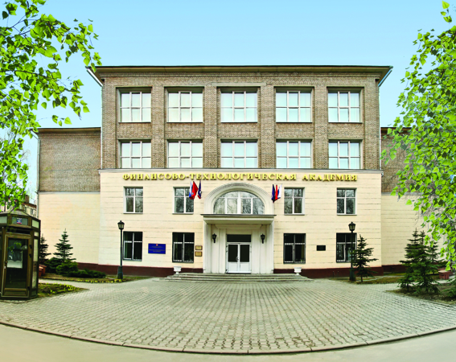
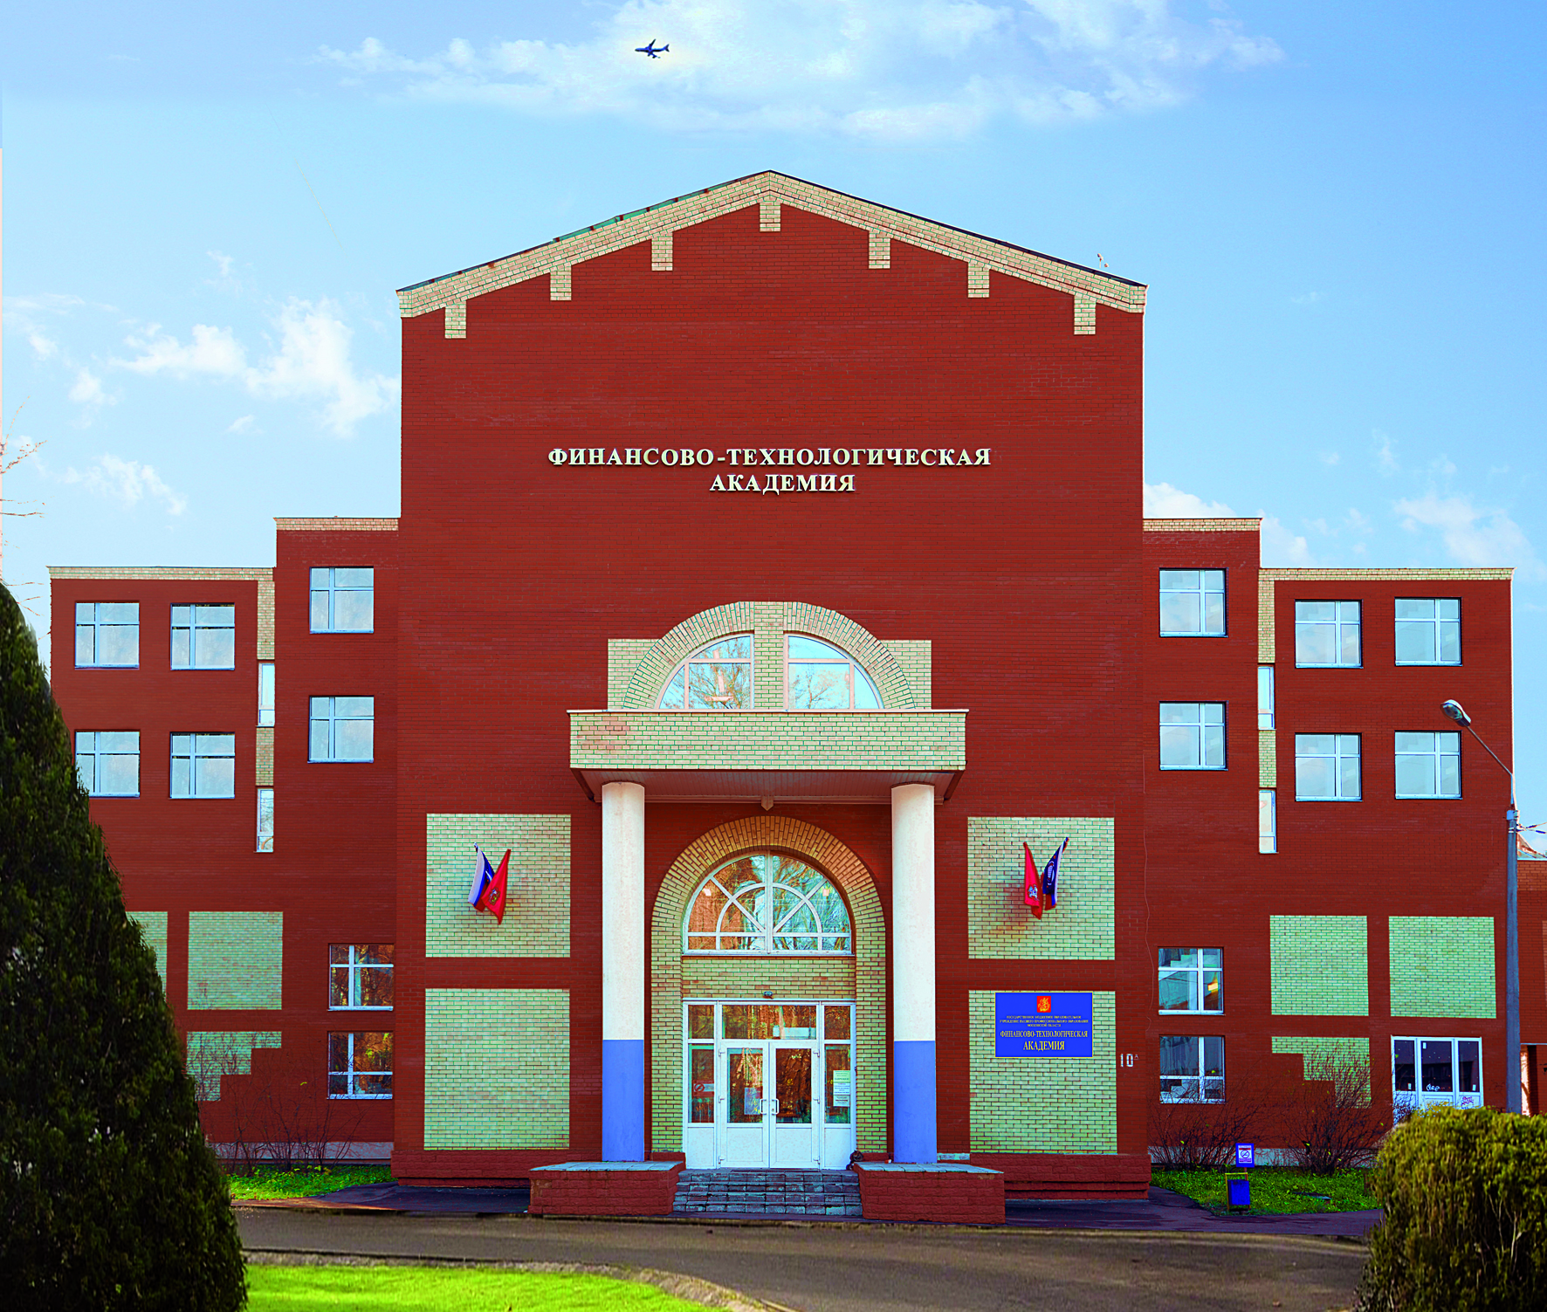
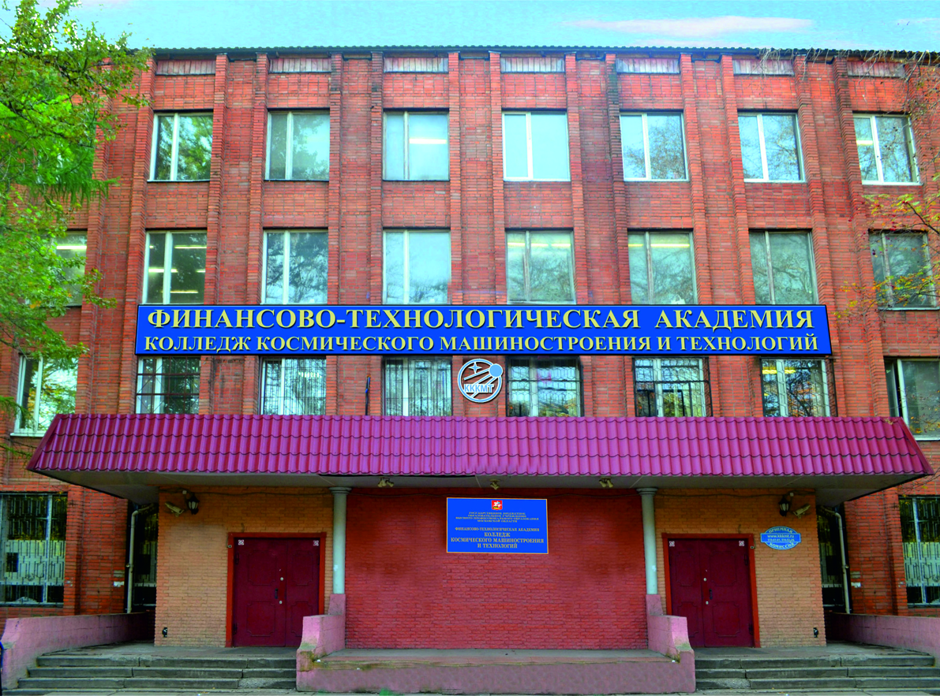
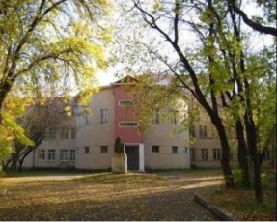
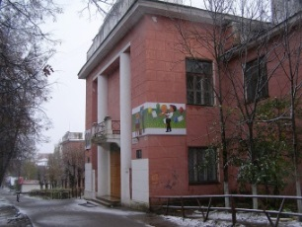
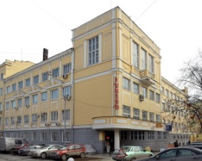
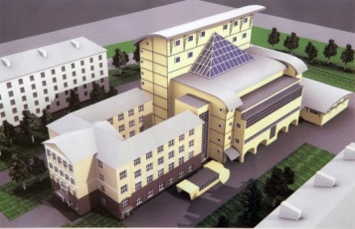
GENERAL INFORMATION
More than 5000 students
Specialities of higher education - 39
Specialities of secondary vocational education - 30
Faculties - 6
Departments - 20
Foreign students - 450
Postgraduate scientific specialities – 8
Dissertation Council
Departments in cooperation with mainstay city enterprises – 8
Scientific Laboratories – 3 (plan to open – 3 new)
Unique equipment
EDUCATION
SCINENTIFIC POTENTIAL
Total area – 42576 sq. meters.
Hostel – 320 places
Computer classes – 23
Modern computers – 670
multimedia classes - 41
Internet electronic-library system
Total employees – 466
Professors – 242
Having a degree – 70%
Scientific workers-lecturers from industrial enterprise - 57
CAMPUS
EMPLOYEES
EDUCATION BUILDINGS
HOSTELS
NEW BUILDING

Slide 3
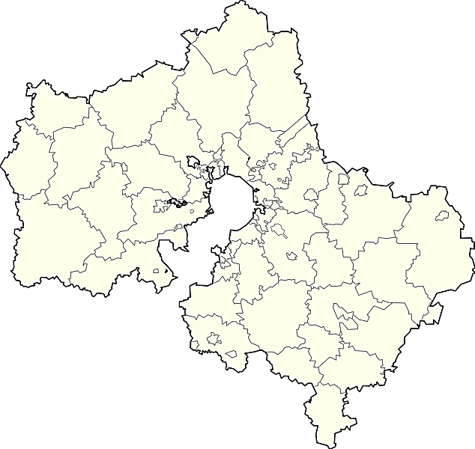
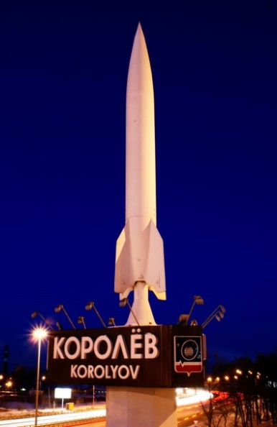
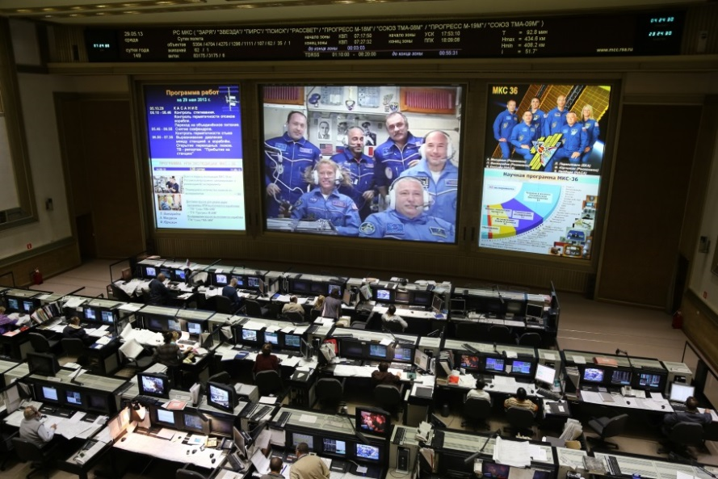
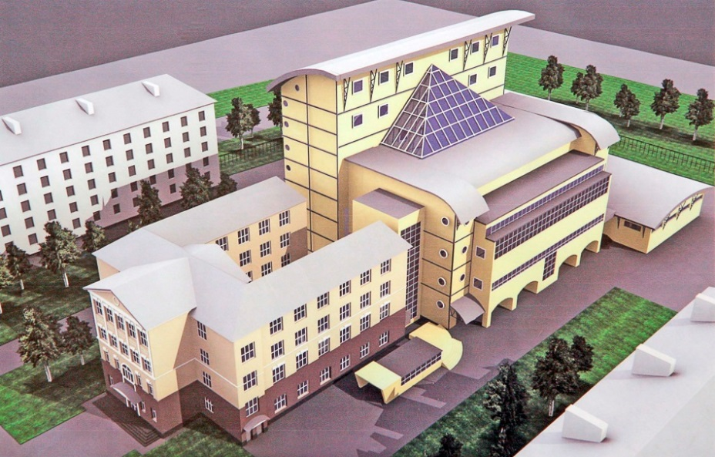
KOROLYOV
«The Finance and Technology Academy (FTA)» are located in Korolyov.
Korolyov is an industrial and science city in Moscow region, Russia, well known as the cradle of Russian space exploration. Population: 183,402
Mission Control Center is located in Korolyov.
Korolyov hosts the International Space Olympics, an annual competition for young people, to promote space related research.

Slide 4
INFORMATION AND TECHNOLOGY FACULTY
Information Technologies and Control Systems / Academy Department
Information technology of missile telemetry /Enterprise Department / NPO “Measuring equipment” (Korolev, Moscow region)
Information Security / Academy Department
Information
and Technology
Faculty
Management and information technology in space systems /Enterprise Department / NII Space systems under the name of A.Maksimov (Yubeleynyy, Moscow region)
Mathematics and Science Education / Academy Department
Engineering and Technologies / Academy Department
Quality management and research in the field of new materials and technologies/ Enterprise Department/ at JSC “Kompozit” (Korolev, Moscow region)
Quality and Standardization Management/ Academy Department

Slide 5
FACULTY OF FINANCE AND ECONOMICS
Accounting and Auditing Department
Corporate management accounting at JSC /Enterprise Department / Tactical missiles corporation“ (Korolev, Moscow region)
Finance and Economic Analysis Department
Faculty of
finance and
economics
Banking /
Enterprise Department /
JSB “Legion” (Korolev,
Moscow Region)
Department of Economics
Banking Department
Custom Business /Enterprise Department / Shchelkovo customs terminal (Shchelkovo, Moscow Region)
Department of Management accounting

Slide 6
SOCIAL-HUMANITIES FACULTY
Department of Social and Humanities
Scientific and educational center for humanities and social and economic researches
Social-
Humanities
Faculty
Department of Applied Psychology
Linguistic Centre “LINGUA” including foreign languages courses and the courses of the Russian language for foreigners
Department of Foreign Languages

Slide 7
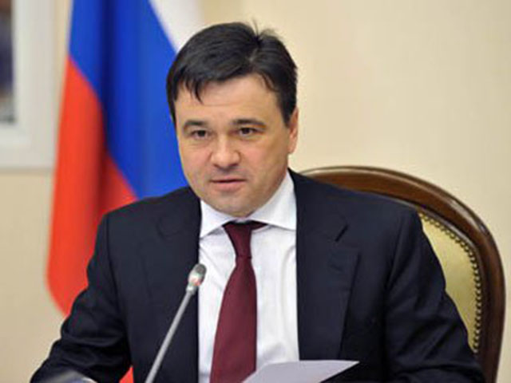
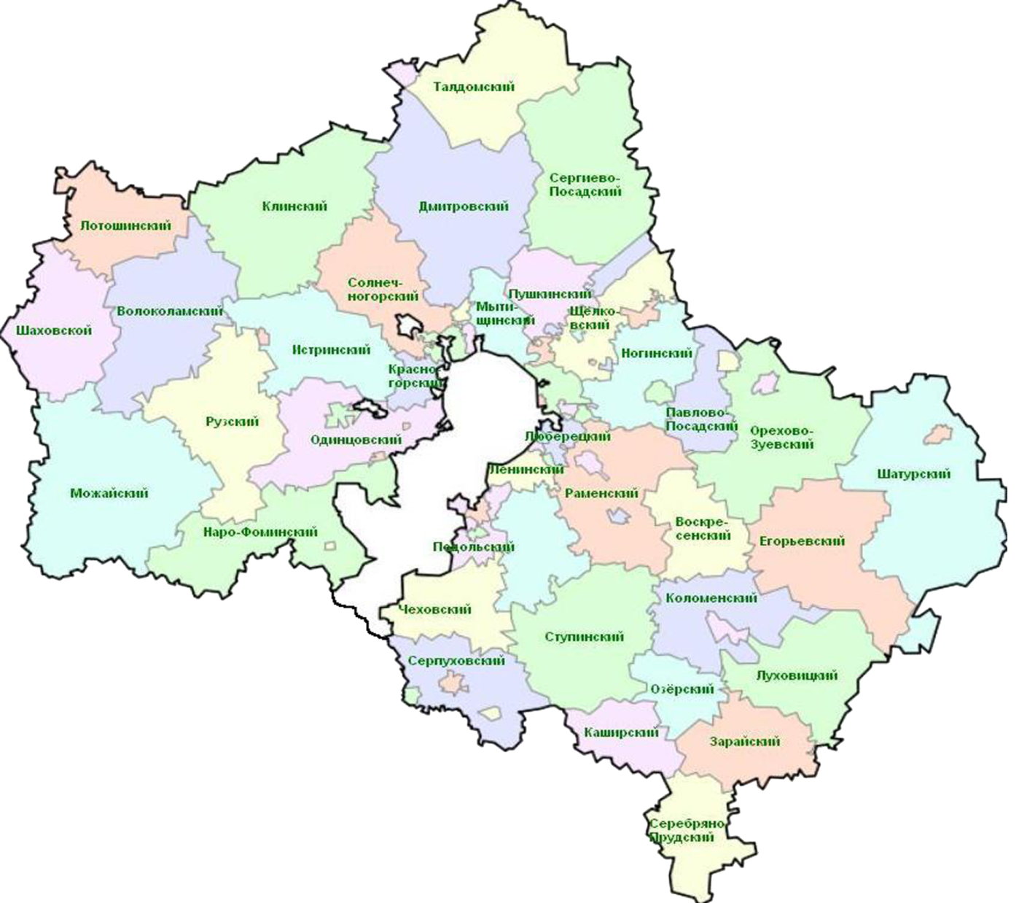
TECHNOLOGICAL UNIVERSITY
To meet the demands for highly qualified personnel of industrial enterprises governor of the Moscow region at the meeting on the development of the city Korolev charged to develop proposals for the establishment of Technological University on the basis of Financial-Technological academy
A. Y. Vorobyev, 16 of March 2014

Slide 8
COOPERATION WITH MAINSTAY SPACE CITY ENTERPRISES

Slide 9
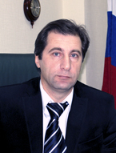
THE DEPARTMENT “QUALITY MANAGEMENT AND RESEARCH IN THE FIELD OF NEW MATERIALS AND TECHNOLOGIES” AT JSC “KOMPOZIT”
TODAY:
The head of department – professor Timofeev A. N., Vice CEO JSC «Komposit», Academician of the Russian Academy of Cosmonautics by KE Tsiolkovsky , Ph.D
Mission: "Training for innovation in the field of new materials and technologies .“
The main research areas:
Development of new composite materials for national security and civil proceedings . Development of new coating technologies . Development of materials and designs for farms and mirrors in space.
Special subjects:
Mechanical and physical properties of materials
Theory and technology of production, processing and recycling of materials and coatings
Test methods for composite structures
Theory of the structure of materials
Modeling and optimization of materials and processes
JSC "Composite" - Materials Research leading enterprise of the Federal Space Agency. Performs research and technological development work on the creation and comprehensive study of the properties of materials.
PROSPECTIVES:
Joint international Russian-Chinese laboratory «Materials science»
Joint Russian-Chinese scientific project in material science

Slide 10
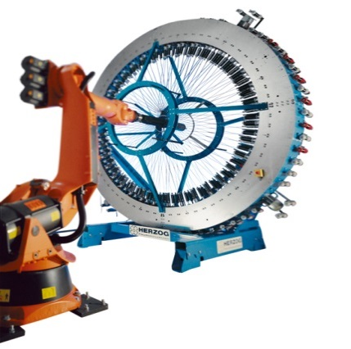
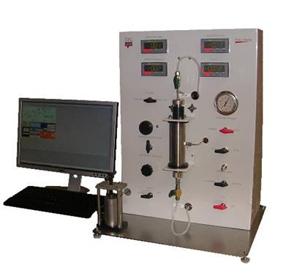
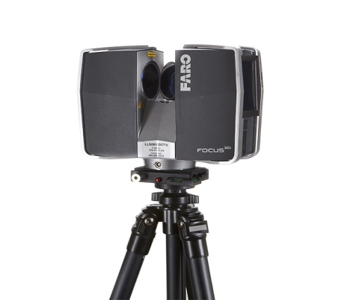
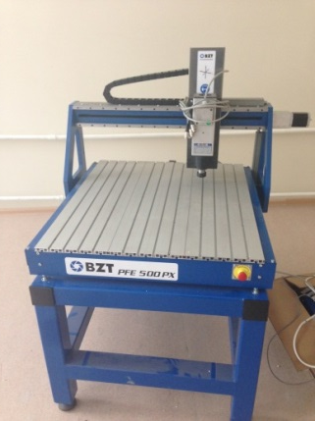
JSC «KOMPOZIT»
LABORATOTIES
1. Laboratory heterogeneous synthesis of advanced materials
Laboratory equipment :
In 2013 purchased: CNC Machine BZT PFE 500 PX, asher EKPS 50 Microscope Altami UCMOS14000KPA, Portable combined hardness, porosimeter; Academic software license ACE + modeling of physical processes
Planned to purchase in 2014: Press APVM-904/63-600-600-2, 3D laser scanner Faro Focus 3D-20
2015: braiding (Braiding) machine Herzog RF 1/144-100
Work plan:
Laboratory work, participation of students, post-graduate research in conjunction with the composite of
2. Joint international Russian-Chinese laboratory «Materials science»
Work plan:
Signing the cooperation agreements in May 2014
Preparing joint applications for funding by the national government resources

Slide 11
RUSSIAN-CHINESE COOPERATION
Sign the science cooperation agreement
Establish the «Materials science» laboratory for research in fields:
High-temperature metal materials
CVI pyrocarbon
Ceramic matrix materials
Nano-ceramics
HIP and 3D printing materials
Inter-metallic alloys
Thermal control paintings
Modelling/simulations of production processes
Apply for funding to local government, national and international institutions
Hold international seminars to exchange research informations
Exchange research students or reseachers for conducting cooperative research
Development and exchange of equipment and devices
Publish papers, make conference presentations and apply for patents

Slide 12
SCIENTIFIC COOPERATION PROPOSAL IN MAKING INTERMETALLIDE ALLOY-BASED ITEMS
1. | The University of Shanghai will perform melting using the vacuum casting with crystallization in a magnetic field and deliver to OJST “Kompozit" the cast slubs of Ni3А1, NiAl or TiAl intermetallide alloy, 55...60 mm in diameter, 450...500 mm long, in the amount of 2 pieces.
2. | The University of Shanghai will analyze the structure and the quality of the cast slub for non-metal inclusions and submit the analysis results to OJSC “Kompozit”.
3. | OJSC “Kompozit” will make powder (grains) of this material, of which will make an experimental compact workpiece using the hot isostatic compaction method.
4. | Financial-technological Academy (FTA) will investigate the structure, the granulometric composition of the powder, as well as the structure and the mechanical properties of the compact workpiece, and submit the results to the University of Shanghai.
5. | FTA and the University of Shanghai will prepare and present the investigation results jointly at an international conference.

Slide 14
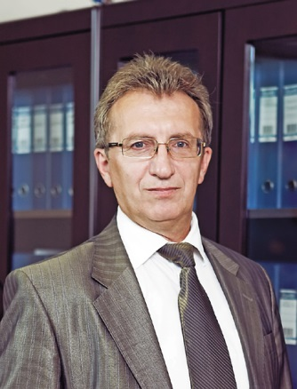
NPO “MEASURING EQUIPMENT”
TODAY:
Department “Information technology of missile telemetry”
The head of department - CEO,
Chief designer of NPO «Measuring equipment» prof.
Artemyev Y. V.
Special subjects:
Designing Sensor-transformative telemetry equipment
Theoretical bases of designing telemetry antennas
Standards of modern telemetry
Fundamentals of the theory of radio telemetry systems
Fundamentals of Radio Engineering
Designing systems for collecting and processing missile telemetry
Through designing tract radio telemetry
Information-measuring system of rocket and space technology
Design of digital devices and pulse
NPO IT - leading center of the telemetry and sensor equipment, microelectronics for rocket and space technology in the field of measuring instruments, remote sensing

Slide 15
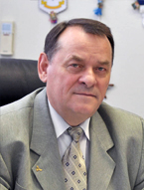
NII SPACE SYSTEMS UNDER THE NAME OF A.MAKSIMOV
TODAY:
Department “Management and information technology in space systems”
The head of department – professor Vokin G. G.
Special subjects:
Space navigation, communication and control
Control system launch vehicle and spacecraft
Basics ballistics missiles and spacecraft
Fundamentals of building rockets and spacecraft
Outobjects systems and telemetry launch vehicle and spacecraft
Terrestrial and space-based systems for monitoring natural resources
Radio equipment of space systems
Remote Sensing
NII Space Systems - leading center of development and investigation of new information, industrial, operational and resource-saving technologies, as well as scientific and technical support for creating, testing and targeted application of advanced rocket and space vehicles

Slide 16
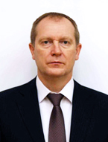
ISAYEV CHEMICAL DESIGN ENGINEERING BUREAU
TODAY:
Department: «Technique and technology of rocket engine»
Specialities:
Aircraft and spacecraft engines
Production of aircraft and spacecraft engines
Research and development in the field of spacecraft engines
Isayev chemical design engineering bureau has experience and capabilities to design and develop :
- liquid fuel rocket engines and boosters with values ​​up to 50 ton thrust ;
- engines and propulsion systems for manned and unmanned spacecraft ;
- impulse engines one - and two-component values ​​thrust from 0.5 kgs to 250 kgs ;
- components and assemblies LRE cameras, turbo pump assemblies , gas generators , regulators, valves, tanks and components for gas cylinders , stainless steel , aluminum and titanium alloys ;
high-efficiency pumps for different liquids ;
- units for different purposes , similar aggregates liquid fuel rocket engines and propulsion systems .

Slide 17
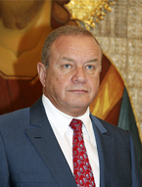
S.P. KOROLEV ROCKET AND SPACE CORPORATION «ENERGIA»
TODAY:
Plans to open 3 Departments:
Design and manufacture of aircraft and spacecrafts (2015)
Industrial Management (2016)
Intelligent Systems and Robotics (2016)
Research in the field of insurance spaceflight
Training speciality: «Automation of technological processes and production»
OAO RSC Energia has been conducting activities in rocket-space industry since 1946 when the team of specialists developing long-range ballistic missiles was organized under the leadership of S.P. Korolev, the Chief Designer of rocket-space system and the founder of practical cosmonautics. The enterprise initiated practically all lines of activity related to national rocket and space technology.

Slide 18
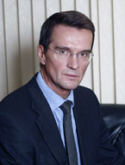
TACTICAL MISSILES CORPORATION JSC
TODAY:
Department «CORPORATE MANAGEMENT ACCOUNTING»
Plans to open 2 Departments:
Automatic control system of missile and aircraft "(2014)
Information security (2015)
Training speciality: Aircraft and Spacecraft Control Systems
Research and development in the design of missile technology long-range
Strategic targets which lead to the Corporation establishment consisted in keeping and developing of missilery’s research and production capacity, supplying national defense capability, resource mobilization needed for highly effective guided missiles and air-based, ground-based, sea-based weapon systems production, also in strengthening military positions of Russia in world armament market.

Slide 19
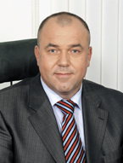
BANK «LEGION»
TODAY:
Department «Banking»
Research on improving business process management of financial institutions
Special subjects:
banking
Market securities and exchange business
Money, credit, banks
Actual problems of Finance
Financial markets and financial credit institutions
In its activities, the Bank "Legion" combines standard banking products with a personal touch to customers in operational issues in all areas of service. The basis of the effective functioning of the Bank is well-developed system of internal control and risk management.

Slide 20
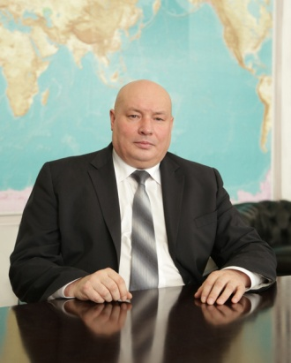
CENTRAL ENGINEERING RESEARCH INSTITUTE FOR MACHINE BUILDING (TSNIIMASH)
TODAY:
Plans to open Department:
DESIGN AND PRODUCTION OF SPECIAL EQUIPMENT (2015)
New specialities:
Designing technology machines and systems
engineering Technology
Research and implementation of space segment alert emergency situations
The Central Research Institute for Machine Building, Federal State Unitary Enterprise is a head scientific and research institution of the Federal Space Agency. For over 60 years the Institute has been participating in development of substantially all launch vehicles (LV), manned spacecraft (SC), orbital stations and unmanned SC.

